Slide 1
Embeded DL (Ardu_DL)
Creator’s Name: Pratham Panchal

Slide 2
Introduction
Embedded DL :
Embedded DL is technique to implement neural networks on hardware with low resources like a microcontrollers.
It is used to implement deep learning models at hardware level or within the electronics circuitry.
It can help handle problems that are non linear in nature or cannot be solved or difficult to solve using conventional algorithms, at hardware level.

Slide 3
Applications of Embedded DL
Battery Health Prediction
Predicts battery voltage drop or estimated charge based on usage time, load, and temperature.
Trained using supervised learning on real-world usage data.
Can be deployed to estimate battery life in portable electronics or drones.
Sensor Error Correction
Corrects raw sensor readings (e.g., IR, thermistor, or IMU) using a trained FFNN that maps raw values to actual values.
Especially useful for cheap or noisy analog sensors.
Avoids hardcoding complex calibration curves or equations.
Simple Environmental Classification System
Predicts environmental states like “safe” or “hazardous” based on multiple sensor inputs (gas, temperature, humidity).
Easier and more flexible than static threshold logic.
Smart DC Motor Drivers
Can trained to drive more safely by determining voltage drop current draw and RPM.
Can be used to maintain linear relation between control signal and RPM or Torque.
Helps avoid unstable behavior under varying loads, without needing complex PID tuning.

Slide 4
Objective of this project
The main objective of this project is to create a technique or framework to create a neural network, train it and implant it in ATMega 352p microcontroller (better known as Arduino UNO).
It involves deriving methods to create a feed forward neural network, train it using supervised learning, a method to store all parameters in a well structured manned or a file as well as handling low resources constraints of a microcontroller.

Slide 5
System Design & Methodology
This frame work have multiple steps involved to implement neural network on Arduino like creation, training, storing, and implementing neural network.
1) Creation, training and storing:
This part of the frame work is written in python.
This program has a class Neural_network to create a neural network. This class manages Layers. This class has functions to create, store, update and read Layers of an existing model that is stored is a specific formate in a text file.
This class also has a function that can help store neural network parameters in a C/C++/Arduino C++ header file and this is what makes this frame work specially usable for embedded deep learning.
This function directly accesses the “FFNN.h” header file stored in Arduino IDE’s library section and modify or assign parameters depending on the network architecture.

Slide 6
System Design & Methodology
In short it literally writes a header file program and stores it in FFNN package in Arduino IDE’s library folder, with parameters like weights and biases stored in arrays.
This program also has functions that can performs forward propagation and back propagation and has two options to choose the type of optimisers to train the neural network.
1) LRS (learning rate scheduling) with momentum, 2) Adam
Currently the activation functions involved is ReLU (Rectified linear unit) but in future versions and updates will have options to choose an activation function.

Slide 7
System Design & Methodology
Arduino Implementation:
The main resource constrain on Arduino Uno is RAM and EEPROM.
Due to this hardware constrains the network array parameters are stored in flash memory Arduino. (As the variables stored in this memory are constant Back propagation or Reinforcement learning is not possible on this microcontroller)
The FFNN package stored in Arduino IDE’s library folder also contains a C++ file that defines a function that performs feed forward or forward propagation to implement the neural network.

Slide 8
Demonstration and result
To demonstrate the working of the model A neural network was created and trained on house price, and rent data depending on different parameters like house age, square feet (area) and few other parameters that were present in dataset.
This demonstration is not based on real world application but instead just to demonstrate the implementation and working of the FFNN (feed forward neural network on Arduino).

Slide 9
Demonstration and result
import pandas as pd
import Deep_learning
import matplotlib.pyplot as plt
df = pd.read_csv("house_data_balanced.csv")
X = df[["square_feet", "bedrooms", "house_age"]].values
y = df[["price","rent"]].values # 1D output
X = (X - X.mean(axis=0)) / X.std(axis=0) # Standardization
y = (y - y.mean(axis=0)) / y.std(axis=0) # Standardize output too
# print(X, y)
my_network = Deep_learning.Neural_network()
params = [4, 3, 32, 64, 32, 2]
# [num layers, input resolution, num neurons in L1, num neurons in L2, num neurons in L3, num neurons in L4]
my_network.generate_random_network(params)
# my_network.read_from_file_txt("my_network2")
costs = Deep_learning.back_prop(X, y, 0.001, my_network.layers, "Adam")
plt.plot(costs)
plt.show()
my_network.update_network_file_txt("my_network2")
my_network.update_network_file_ino()
my_network.update_network_file_cpp()
# network_output = Deep_learning.forward_prop(my_network.layers, X)

Slide 10
Demonstration and result
The above provided code was a python code that generates a neural network with four layers and an input layer with 3 inputs.
It uses back prop function to train the neural network and also get the list of cost to see how the cost function decreases over the period of time.
At last it uses update function to store neural network in multiple files like a C++ header file, text file and Arduino header file.

Slide 11
Demonstration and result
#include<FFNN_avr.h>
float input_value[3];
void setup() {
Serial.begin(9600);
while(!Serial);
}
In the above given block of Arduino code FFNN_avr header file is included that contains the parameters of neural network and a function to implement forward propagation.
It has a simple void setup as it only needs to initialize Serial communication with our device that will send input data like square_feet,bedrooms,house_age and receive output.

Slide 12
Demonstration and result
void loop() {
if(Serial.available()>0){
String data = Serial.readStringUntil('\n');
int firstComma = data.indexOf(',');
int secondComma = data.indexOf(',', firstComma + 1);
if (firstComma != -1 && secondComma != -1) {
input_value[0] = data.substring(0, firstComma).toFloat();
input_value[1] = data.substring(firstComma + 1, secondComma).toFloat();
input_value[2] = data.substring(secondComma + 1).toFloat();
}
float * output_value = feed_forward(input_value);
Serial.print(output_value[0]);
Serial.print(",");
Serial.println(output_value[1]);
delete[] output_value;
}
delay(10);
}

Slide 13
Demonstration and result
The above given code in void loop reads input data like square_feet,bedrooms,house_age from serial port and outputs data like price,rent.
This is the dataset on which the FFNN is trained that is stored in the header file.
Now the below given python code is used as an interface to run the demonstration and observe the results on predicted output vs actual output.

Slide 14
Demonstration and result
import pandas as pd
import serial
import time
import numpy as np
import matplotlib.pyplot as plt
df = pd.read_csv("house_data_balanced.csv")
# print(df)
X = df[["square_feet", "bedrooms", "house_age"]].values
y = df[["price","rent"]].values # 2D output
X_mean = X.mean(axis=0)
X_std = X.std(axis=0)
y_mean = y.mean(axis=0)
y_std = y.std(axis=0)
x = (X - X_mean) / X_std # Standardization
# y = (y - y_mean) / y_std
ser = serial.Serial('COM4', 9600, timeout=1)
time.sleep(5)

Slide 15
Demonstration and result
Y = []
i=0
for x_1d in x:
data = f"{x_1d[0]},{x_1d[1]},{x_1d[2]}\n"
print("Sending data : ", data)
ser.write(data.encode())
while not ser.in_waiting:
pass
if ser.in_waiting > 0:
response = ser.readline().decode('utf-8').strip()
outputs = [float(resp) for resp in response.split(",")]
Y.append(outputs)
# print(outputs)
# print(y[i])
i+=1
time.sleep(0.015)
original_values = y
network_output = (np.array(Y)*y_std)+y_mean
ser.close()

Slide 16
Demonstration and result
plt.figure(figsize=(8, 5))
plt.plot(original_values, 'bo-', label="Original Values")
plt.plot(network_output, 'r*-', label="Predicted Values")
plt.xlabel("Index")
plt.ylabel("Value")
plt.title("Original vs Predicted Values")
plt.legend()
plt.grid(True)
plt.show()

Slide 17
Demonstration and result
The above provided demonstrator code sends normalized input data and gets normalized output data and then de-normalize it to convert it into house price data for better readability.
First it includes all libraries and setups the serial communication and gets data from CSV.
Then it starts sending and receiving data over Serial port.
Then in the last section it plots the data on the graph to show the result.

Slide 18
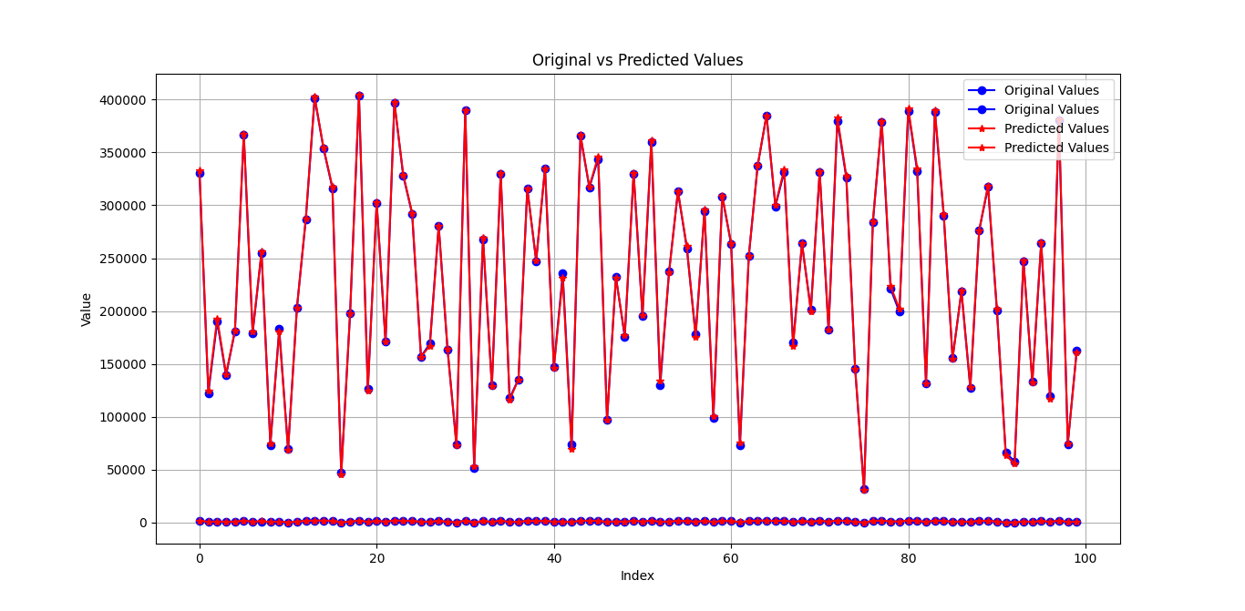
Demonstration and result

Slide 19
Demonstration and result
The above given graph shows the output of the Arduino that almost coincides with actual output.
The Arduino in total had around 130 neurons and this consumed around 75% of it’s flash memory.
The training was done with normalized data as the real data generated huge cost and derivative values to fit in a float. With 1500 epochi and a final cost of network around 0.001102.

Slide 20
Thank you and have a good day.

